Slide 1

Database Design & Programming
SQL Subqueries
Chapter 12

Slide 2
Subqueries and Their Uses
Subquery – a query nested inside another query
Used when a query is based on an unknown value
Requires SELECT and FROM clauses
Must be enclosed in parentheses
Subqueries are often required to solve a problem when multiple steps to arrive at a solution.
Oracle 12c: SQL
2

Slide 3
Aspects of Subqueries
Subquery | Description | Comments
Single Row Subquery | Returns one row of results | Use =, >, >=, <, <=, and != operators
Multi Row Subquery | Returns a set of rows as a result | Use IN, ANY..., ALL.. and EXISTS
Single Column subquery | Returns a single column as a result | Use =, >, >=, <, <=, and != operators
Multi Column subquery | Returns multiple columns as a result | IN, =ANY Syntax (xxx, uuu) operator
Correlated subquery | Subquery reference a table in the outer query and executes the subquery once for each row in the outer querty | Select a,b,c From books bouter Where yyyy = (select zzz from books binner where bouter.xxx = binner.xxx)
Uncorrelated subquery | Executes the subquery first and returns the result to the outer query
Oracle 12c: SQL
3

Slide 4
Comparing Single Row versus Multi-Row Subqueries

Slide 5
Single-Row Subqueries
Can only return one result to the outer query
Operators include =, >, <, >=, <=, < >
Oracle 12c: SQL

Slide 6
Single-Row Subquery in a WHERE Clause
Used for comparison against one data item
Find all books whose retail price is more than the retail price of the book ‘DATABASE IMPLEMENTATION’. Include the title and retail price on the report. Sort by title.
    xx
Oracle 12c: SQL

Slide 7
Single-Row Subquery in a HAVING Clause
Required when returned value is compared to grouped data.
Since the comparison is against the group the HAVING clause is required.
Show all categories whose average profit is greater than the average profit of the ‘LITERATURE’ category. Show the category name and the average profitability.
Oracle 12c: SQL

Slide 8
Profit Categories > Literature
  xx

Slide 9
Single-Row Subquery in a SELECT Clause
Replicates subquery value for each row displayed
Show each category, show the price of the most expensive books in that category and the price of the most expensive book in the bookstore.
    xx
Oracle 12c: SQL

Slide 10
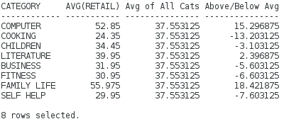
Subqueries in other clauses
For each category show the average price of books in the category, the average price of all categories, and how much the average price of this category is above or below the average of all the categories.

Slide 11
Solution
xx

Slide 12
Multiple-Row Subqueries
Subquery returns more than one row of results
Require use of IN, ANY, ALL, or EXISTS operators
Oracle 12c: SQL

Slide 13
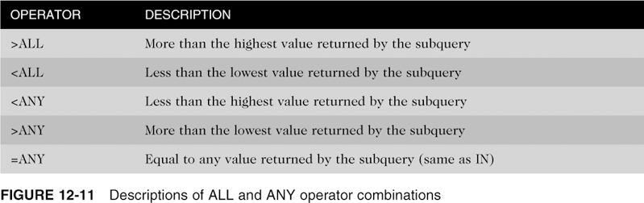
Multi-Row Operators
Combine with arithmetic operators
Oracle 12c: SQL

Slide 14
Multiple-Row and Multi-Column
Subquery in a WHERE Clause #1
Show the most expensive book in each category.
The inner query (a set of category and max retail)
    xx
Now write the outer query to find the book in that category with that price.
Note: Could use IN operator or =ANY
Oracle 12c: SQL
14

Slide 15
Multiple-Row Subquery in a WHERE Clause #1
  xx

Slide 16
Multiple-Row Subquery in a WHERE Clause #2
Find all books whose retail price is less than the price of any computer book in the bookstore. Show the title, retail price and category. The list should not include computer books. Sort by title.
  xx
Oracle 12c: SQL
16

Slide 17
Multiple-Row Subquery in a HAVING Clause
Find all orders whose value is greater than the value of orders placed by customers in Florida. Show the order# and value of the order. Sort by order#.
    xx
Oracle 12c: SQL
17

Slide 18
Using EXISTS
  Show all authors
    xx
  Show all authors that have sold at least one book. Requires correlation between inner and outer query.
    xx
Notes:
EXISTS – returns TRUE if a subquery returns at least one row. Inner query is correlated to outer query

Slide 19
Using EXISTS
Show authors that have NOT written any books.
    xx

Slide 20
Comparing Single Column versus Multi-Column subqueries

Slide 21
Single Column Subquery
Show all the customers (non-NE region) that have ordered the same books as customers in the NE region.
    xx

Slide 22
Multiple-Column Subqueries
Return more than one column in results
Can return more than one row
Column list on the left side of operator must be in parentheses
Use the IN operator for WHERE and HAVING clauses
Oracle 12c: SQL
22

Slide 23
Multiple-Column Subquery in a WHERE Clause
Returns multiple columns for evaluation
What is the lowest price book in each category?
  the category AND retail price must match members of the inner set
  xx
Oracle 12c: SQL

Slide 24
Multiple-Column Subquery in a FROM Clause
Creates a temporary table
Find all books whose retail price is more than the average price of books in the same category. Sort by category and title.
Oracle 12c: SQL

Slide 25
Multi-Column in FROM clause
Solution:
  xx

Slide 26
Dealing with NULL values
When a subquery might return NULL values, use NVL function
Allow the user to enter a customer # and then find all people who were referred by the same person who referred this customer.
accept customerNum NUMBER PROMPT 'Enter Customer #’
SELECT customer#
FROM customers
WHERE referred =
(SELECT referred
FROM customers
WHERE customer#=&&customerNum) and customer# != &&customerNum;
Oracle 12c: SQL
Notes:
-- run accept FIRST and then the SELECT statement after
accept customerNum NUMBER PROMPT 'Enter Customer #’
SELECT customer#
FROM customers
WHERE referred =
(SELECT referred
FROM customers
WHERE customer#=&&customerNum) and customer# != &&customerNum;

Slide 27
Nested Subqueries
Maximum of 255 subqueries if nested in the WHERE clause
No limit if nested in the FROM clause
Innermost subquery is resolved first, then the next level, etc.
Oracle 12c: SQL
27
Notes:
<<

Slide 28
Nested Subqueries (continued)
Innermost is resolved first (A), then the second level (B), then the outer query (C)
Oracle 12c: SQL

Slide 29
Nested Subqueries
Find the customer that has the largest number of items on an individual order.
  xx

Slide 30
Comparing Correlated versus Uncorrelated subqueries

Slide 31
Uncorrelated Subqueries
Processing sequence
  Inner query is executed first
  Result is passed to outer query
    ALL the rows
  Outer query is executed
Oracle 12c: SQL
31

Slide 32
Correlated Subqueries
For each row in the outer query the inner query is executed once
Inner query references a row contained in the outer query
Can only be solved using:
  Traditional join
  JOIN...ON
Oracle 12c: SQL
32

Slide 33
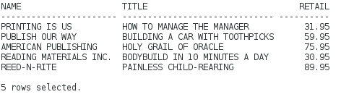
Correlated Subqueries versus Uncorrelated Subqueries
Show the most expensive book published by each publisher.
Oracle 12c: SQL
33

Slide 34
Comparing a correlated to an uncorrelated solution
Find the value of Most Expensive book for each publisher.

Slide 35
Uncorrelated approach
Uncorrelated solution
    xx

Slide 36
Correlated solution
Show the most expensive book published by each publisher.
Link the pubID in the outer query to the pubID in the inner query
For each book look at the publisher and determine if this is the most expensive book for that publisher.
Correlated Solution
    xx

Slide 37
Correlated Subqueries Explanation
Correlated approach
  correlate the inner publisher based on the outer publisher
  For each book b
  if b.retail = (find max retail for book with the
  same publisher as outer query)
  print info for this book
  endif
  next
Inner query MUST be able to reference data in the outer query, therefore, correlated queries can only be done using:
  Traditional method
  JOIN...ON
Oracle 12c: SQL
37

Slide 38
Creating an Inline View
An inline view is a temporary table created by using a subquery in the FROM clause
It can only be referenced while the command is being executed
Most common usage – “TOP-N” analysis
©2016. Cengage Learning. All rights reserved.
38

Slide 39
“TOP-N” Analysis
ORDER BY included to identify top values:
  Descending for highest values
  Ascending for lowest values
Extract data based on ROWNUM
©2016. Cengage Learning. All rights reserved.
Notes:
By analysing the ROWNUM from the subquery we can restrict the number of rows returned

Slide 40
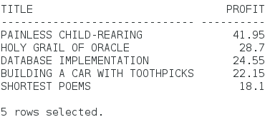
Top 5 most profitable books
List the top 5 most profitable books (in $ terms)

Slide 41
Top 5 most profitable books
Start with a sorted list
  xx

Slide 42
Top 5 most profitable books
Create a numbered list restrict to the top 5 books
  xx

Slide 43
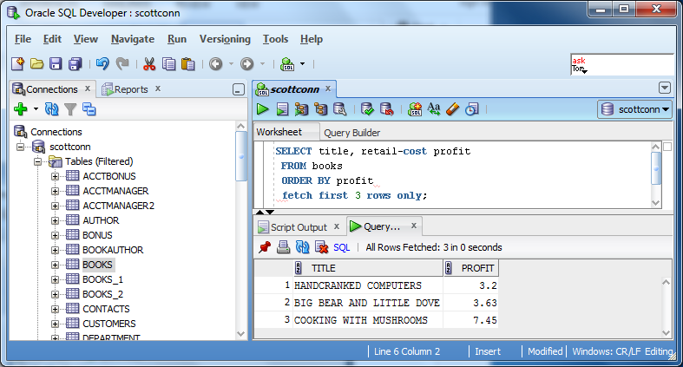
“TOP-N” Analysis (continued)
Oracle 12c introduces a new row limiting clause (# rows)
©2016. Cengage Learning. All rights reserved.
Notes:
Again another way to find the top n rows.

Slide 44
Top 5 most profitable books using Oracle 12c
Restrict the number of rows displayed
  select title, retail-cost profit
  from books
  order by profit desc
  xx

Slide 45
Page-Oriented Queries
Write a page-based query to display the first page of customer orders (Order 1-5)
Write a page-based query to display the second page of customer orders (6-10)
Basic Query
  select firstname, lastname, order#
  from customers join orders using (customer#)
  order by 2,1,3;

Slide 46
Display Page 1 (Orders 1 – 5)
select firstname, lastname, order#
from customers join orders using (customer#)
order by 2,1,3
xx

Slide 47
Display Page 2 (Orders 6-10)
select firstname, lastname, order#
from customers join orders using (customer#)
order by 2,1,3
xx

